Slide 1

Jefferson Lab – The Next Ten Years and Beyond
Hugh Montgomery
Hampton University
March 31, 2011

Slide 2
Abstract
Jefferson Lab had its 25th anniversary a little more than a year ago. After successful operation of its 6 GeV continuous wave superconducting radiofrequency accelerator for a decade, the laboratory is constructing an upgrade to double the energy of the accelerator to 12 GeV, and to extend its experimental capabilities. The result will be an exciting physics program, which will extend well beyond 2020. The beautiful superconducting radio-frequency technology also offers other opportunities, for example, in photon physics.

Slide 3
Acknowledgements
This talk is derived from a number of presentations prepared by my colleagues at Jefferson Lab over the past couple of years.
I am especially grateful for the input from Larry Cardman, Rolf Ent, Joe Grames, Doug Higinbotham, Andrew Hutton, Allison Lung, Bob McKeown, George Neil, and Gwyn Williams.

Slide 4
The Talk
Jefferson Lab today
12 GeV; The Physics Opportunities
12 GeV; The Project Status
Other Initiatives
Conclusions
Notes:
Like to give an overview of Jefferson Lab.
I can’t get going without saying something of the current status of the lab.
The dominant part of the talk will concern our 12 GeV Upgrade Project, the physics and the project status.
However, the technology which enables our nuclear physics and its enhancement also provides opportunities in the future
Photon Science
Accelerator Driven Systems
Nuclear Physics
Conclude

Slide 5
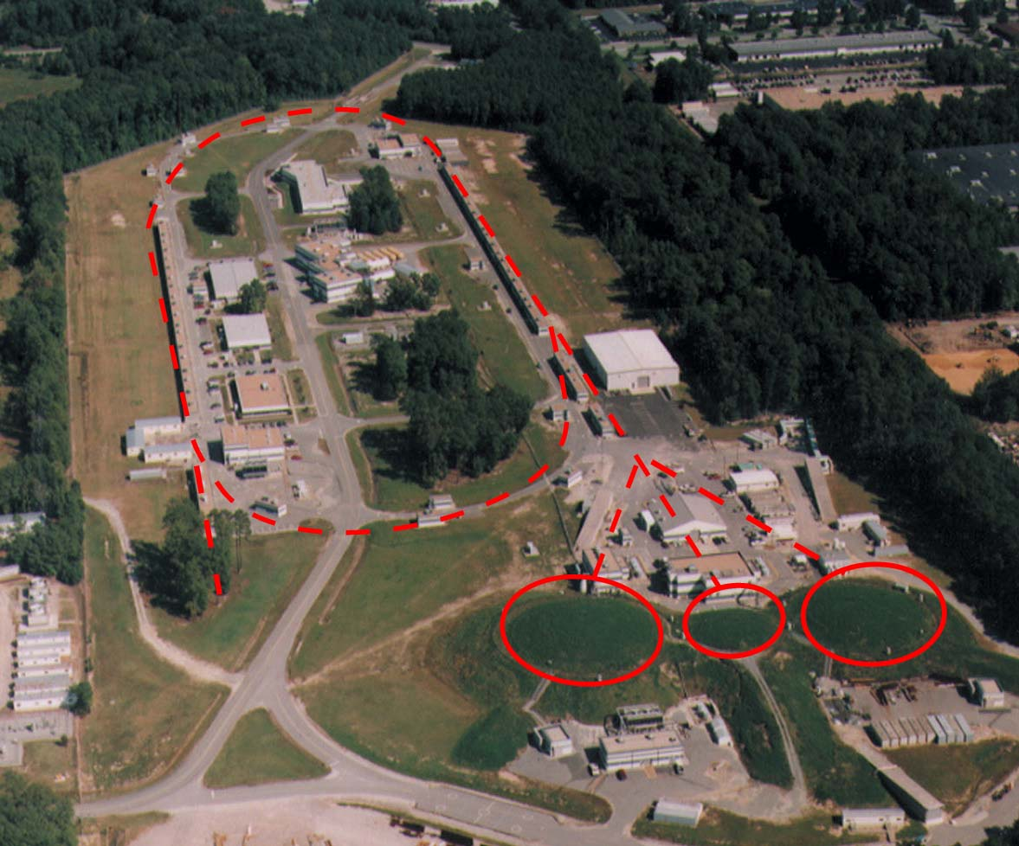
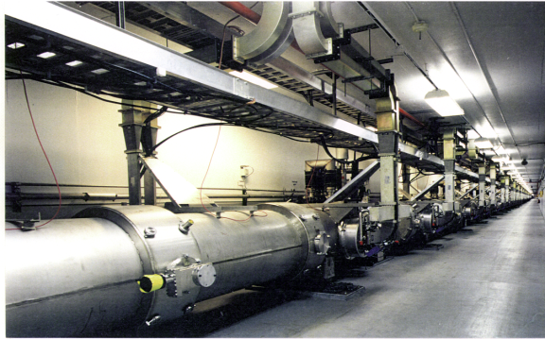
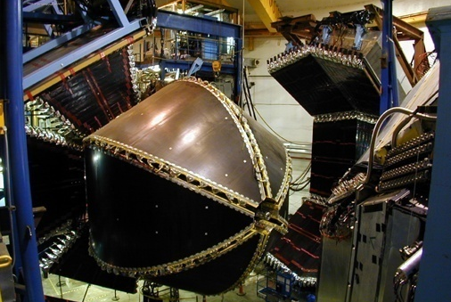
JEFFERSON LAB TODAY
>1200 active member international user community engaged in exploring quark-gluon structure of matter.
Newport News, VA
Superconducting electron accelerator provides 100% duty factor beams of unprecedented quality, with high polarization at energies up to 6 GeV.
A
B
C
CEBAF’s delivery of beam with unique properties to
three experimental halls simultaneously. Each hall offers different capabilities.

Slide 6
Electron Scattering: A picture

Slide 7
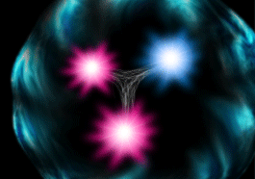
The Structure of the Proton
Naïve Quark Model: proton = uud (valence quarks)
QCD: proton = uud + uu + dd + ss +
The proton sea has a non-trivial structure: u ≠ d
The proton is far more than just its up + up + down (valence) quark structure
Notes:
From a certain point of view, the proton is a simple object made up of three quarks.
In practice, much more complex, three valence quarks, but a sea of quark anti-quark pairs, and gluons. Since the seventies, it has been understood that only 50% of the momentum is carried by the quarks and anti-quarks, original experimental evidence for glue… and to this day, we are trying to understand how the static properties of the nucleon are generated by the constituents.

Slide 8
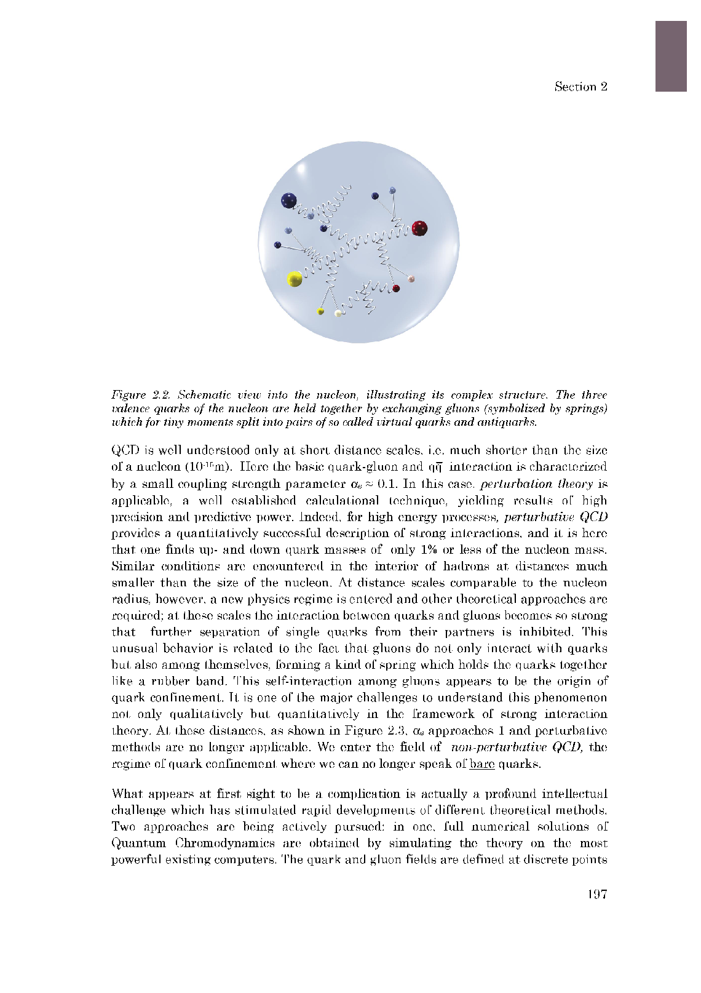
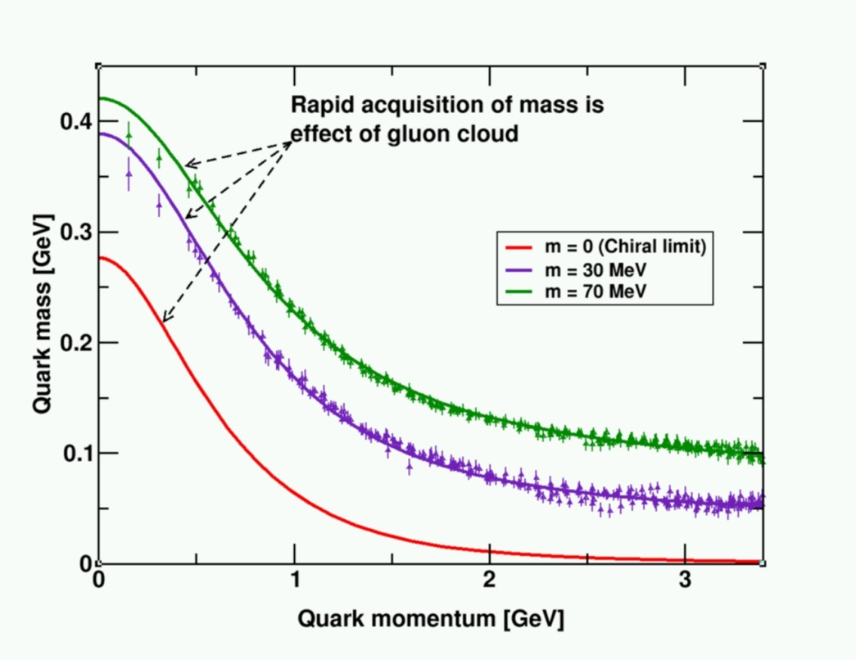
QCD and the Origin of Mass
99% of the proton’s mass/energy is due to the self-generating gluon field
  Higgs mechanism has almost no role.
The similarity of mass between the proton and neutron arises from the fact that the gluon dynamics are the same
  Bare quarks contribute almost nothing.

Slide 9
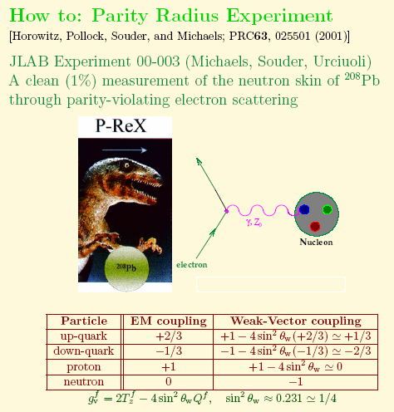
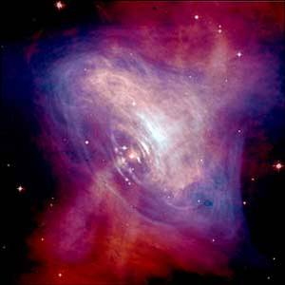
PREX : ²⁰⁸Pb Radius Experiment
Low Q² elastic e-nucleus scattering
(E = 850 MeV, Θ=6^{ο} )
0
Z (Weak Interaction) :
couples mainly to neutrons
Sensitive to neutron radius
Measure a Parity Violating Asymmetry
Fundamental check of
Input to Atomic PV Expts
Neutron Star Structure
Nuclear Theory

Slide 10
12 GeV Upgrade
New Hall
CHL-2
Maintain capability to deliver
lower pass beam energies
Enhanced capabilities in existing Halls

Slide 11
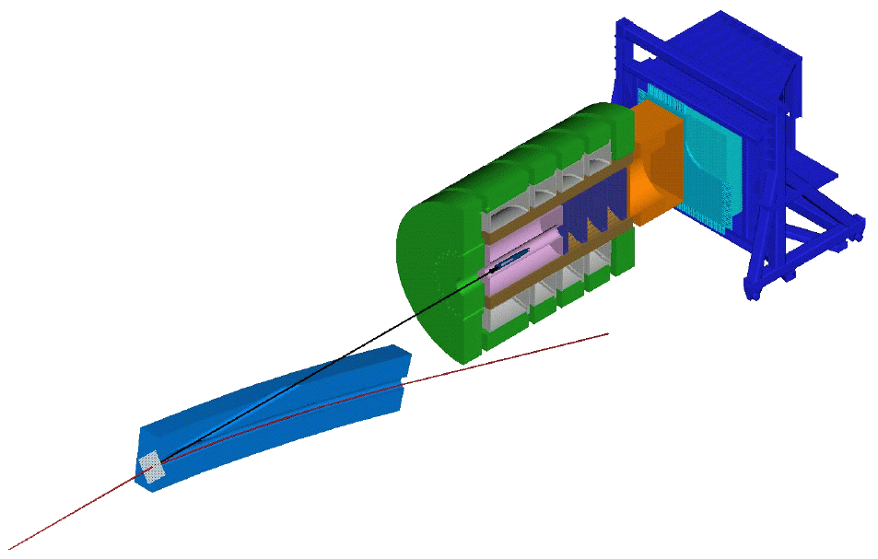

Hall D Glueχ
Barrel
Calorimeter
Lead Glass
Detector
Solenoid
Target
Coherent Bremsstrahlung
Photon Beam
Note that tagger is
80 m upstream of
detector
Time of
Flight
Forward Drift
Chambers (FDC)
Cerenkov
Counter (descoped)
Central Drift
Chambers (CDC)
Electron Beam from CEBAF

Slide 12
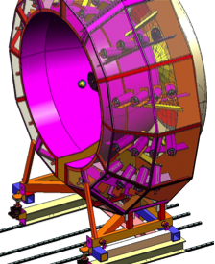
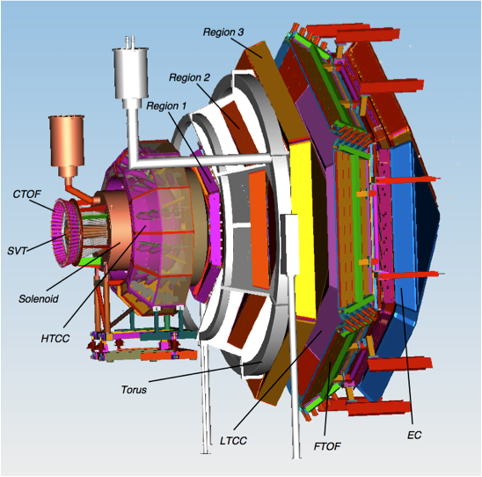
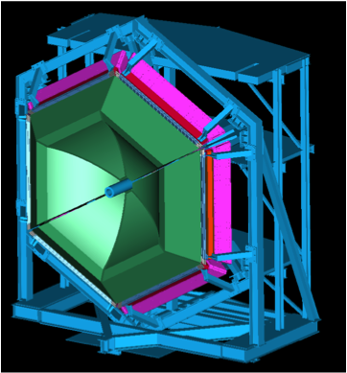
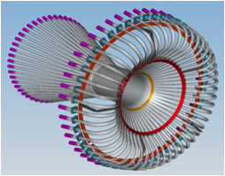
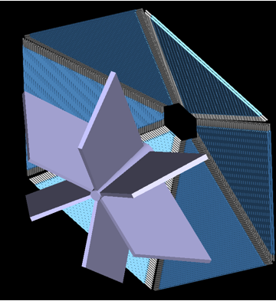
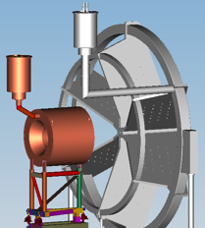
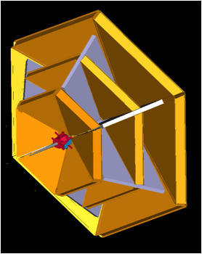
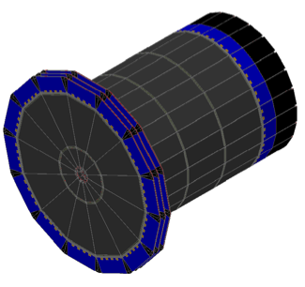
Hall B
CLAS12
PCAL
HTCC
FTOF
CTOF
Silicon Tracker
Drift Chambers
R1, R2, R3
Solenoid &Toroid

Slide 13
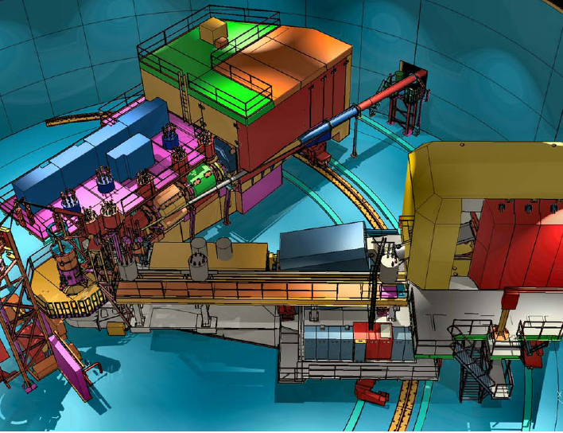
Hall C
New Super High Momentum Spectrometer (SHMS) Horiz. Bender, 3 Quads + Dipole
P →11 GeV/c
dP/P 0.5 –1.0x10⁻³
Acceptance: 5msr, 30%
5.5°< θ< 40°
High Momentum
Spectrometer (HMS)
P →7.5 GeV/c
ΔP/P = 0.5 –1.0x10⁻³
Acceptance: 6.5msr, 18%
10.5°< θ< 90°
Minimum opening angle: 17°

Slide 14
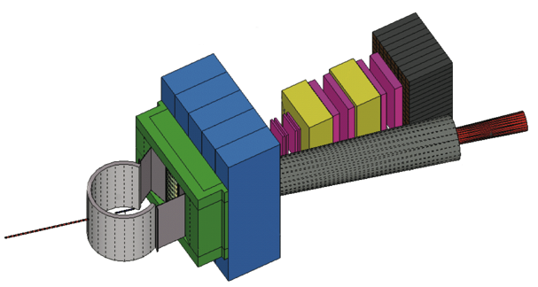
Super Bigbite Spectrometer (SBS) in Hall A
Third tracker
Second tracker
Hadron calorimeter
First tracker
Vacuum snout
Scattering chamber
Beam line Pb shield
CH2 analyzer
Beam
48D48 magnet
Magnetic shield
MIE Funding schedule under discussion with DOE

Slide 15
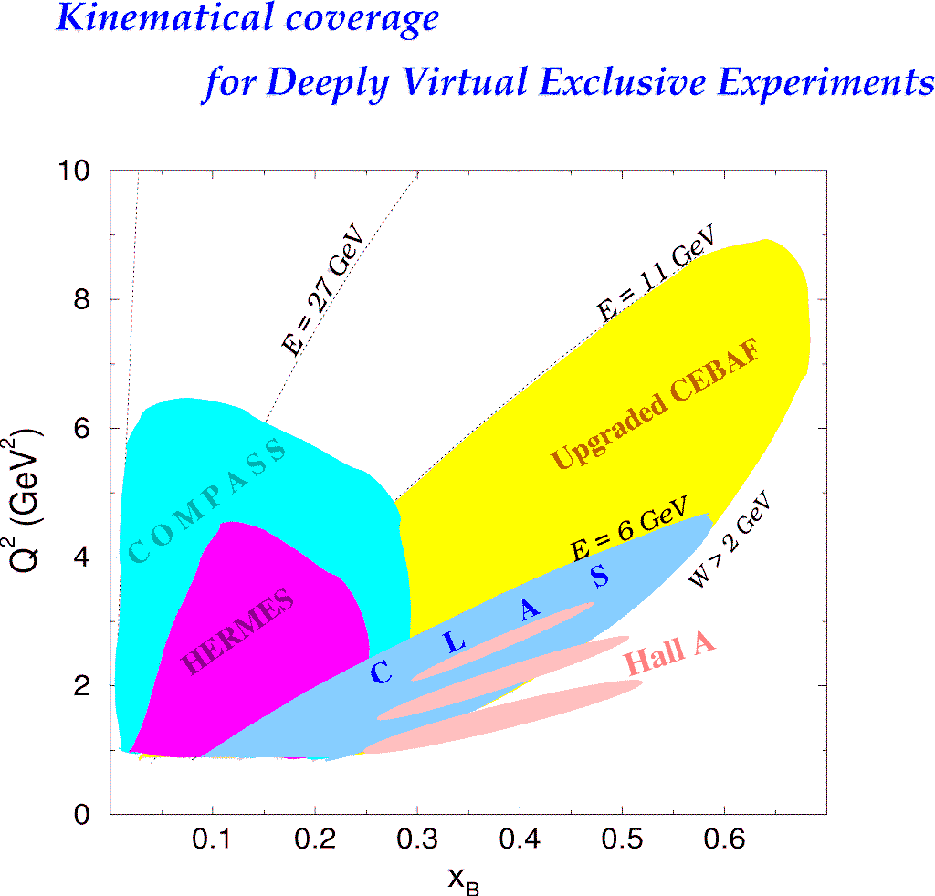
Kinematic Coverage of the 12 GeV Upgrade
H1, ZEUS
Study of high x_{B} domain
requires high luminosity
H1, ZEUS
27 GeV
11 GeV
200 GeV
11 GeV
JLab Upgrade
JLab @ 12 GeV
COMPASS
W = 2 GeV
HERMES
The 12 GeV Upgrade is well matched to studies in the valence quark regime.
0.7
Notes:
The kinematics range that can be covered in exclusive processes with high precision data is shown with this yellow area. This will be the only accelerator where rhe valence quark regime can be fully covered with high precision data. other existing machines, even at much higher energies can not cover this regime due to the much lower luminosity at HERA or COMPASS.

Slide 16
12 GeV Physics seen by the Physics Advisory Committee
The Hadron spectra as probes of QCD
(GlueX and heavy baryon and meson spectroscopy)
The transverse structure of the hadrons
(Elastic and transition Form Factors)
The longitudinal structure of the hadrons
(Unpolarized and polarized parton distribution functions)
The 3-D structure of the hadrons
(Generalized Parton Distributions and Transverse Momentum Distributions)
Hadrons and cold nuclear matter
(Medium modification of the nucleons, quark hadronization, N-N correlations, hypernuclear spectroscopy, few-body experiments)
Low-energy tests of the Standard Model and Fundamental Symmetries
(Møller, PVDIS, PRIMEX, …..)

Slide 17
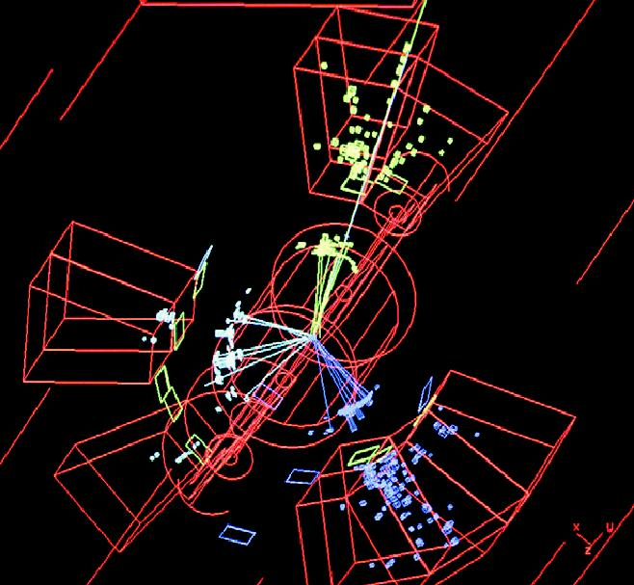
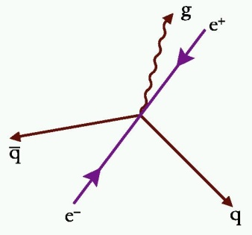
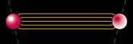
QCD and confinement
Asymptotic Freedom
Confinement
Small Distance
High Energy
Large Distance
Low Energy
Perturbative QCD
Strong QCD
High Energy Scattering
Spectroscopy
Gluon
Jets
Observed
Gluonic
Degrees of Freedom
Missing
Notes:
The Hadron Spectra as Probes of QCD

Slide 18

Hybrid mesons and mass predictions
q
Hybrid mesons
1 GeV mass difference
q
q
Normal mesons
q
J^{pc} = 1⁻⁺
Lattice
1⁻⁺ 1.9 GeV
2⁺⁻ 2.1 GeV
0⁺⁻ 2.3 GeV
Lowest mass expected to be p₁(1⁻⁺) at 1.9±0.2 GeV
Notes:
The Hadron Spectra as Probes of QCD

Slide 19
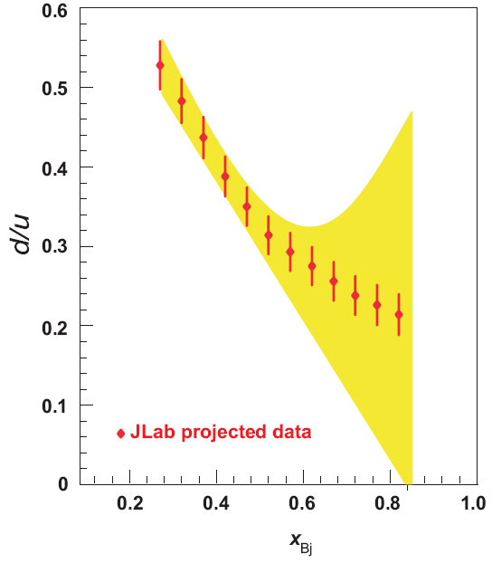
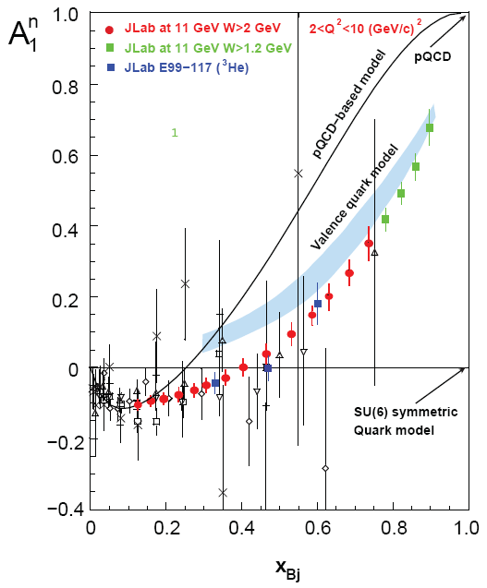
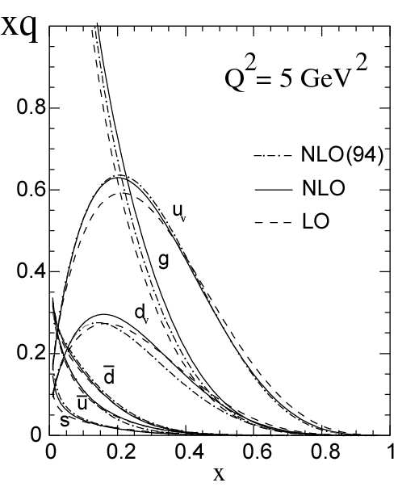
Measuring High-x Structure Functions
REQUIRES:
High beam polarization
High electron current
High target polarization
Large solid angle spectrometers
12 GeV will access the regime (x > 0.3), where valence quarks dominate
Notes:
From a field theoretic perspective, nuclei are a separate solution of QCD Lagrangian
Not a simple convolution of free nucleon structure with Fermi motion
‘Point nucleons moving non-relativistically in a mean field’ describes lowest energy states of light nuclei very well
But description must fail at small distances

Slide 20



Generalized Parton Distributions (GPDs)
X. Ji, D. Mueller, A. Radyushkin (1994-1997)
Proton form factors, transverse charge & current densities
Structure functions,
quark longitudinal
momentum & helicity
distributions
Correlated quark momentum
and helicity distributions in
transverse space – GPDs, TMDs
Notes:
The 3D structure of the nucleon

Slide 21
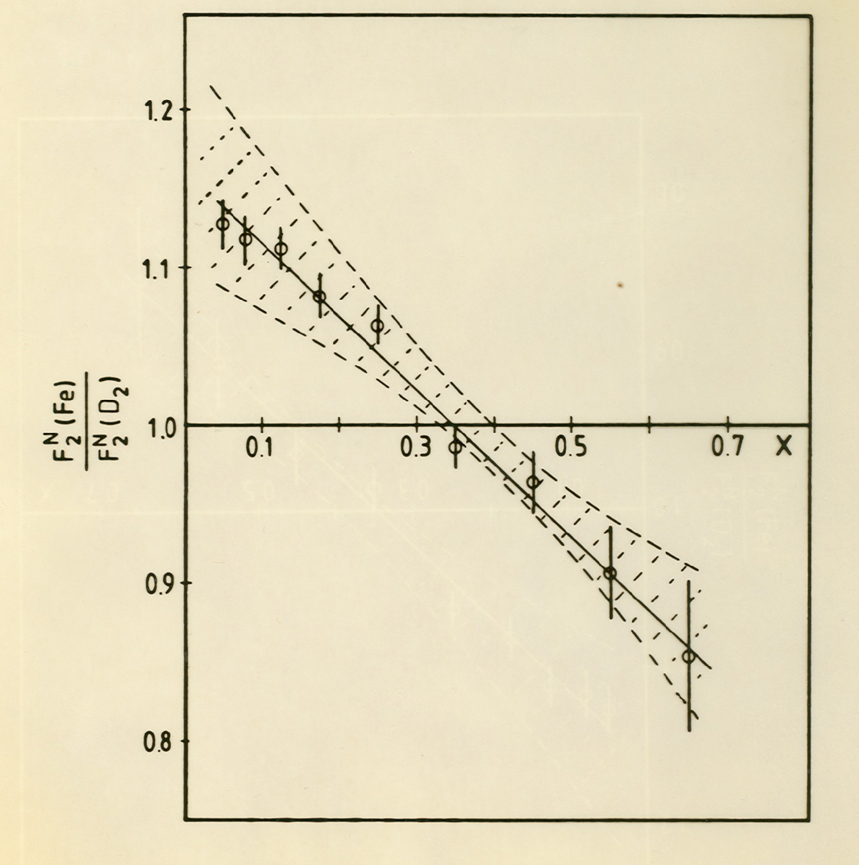
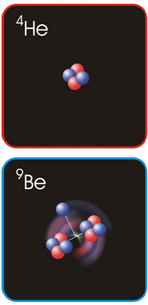
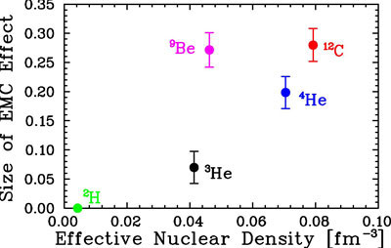
The Nucleus : The EMC Effect
1982 2009
EMC Effect Observed Origins Still Obscure
Local Density Effect?

Slide 22
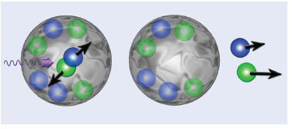
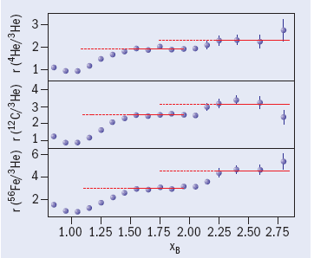
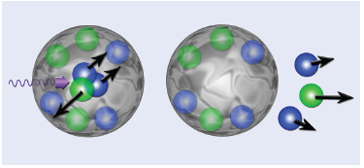
Nucleon-Nucleon Short Range Correlations
Strong multi-nucleon component indicating short range correlations
p-n dominates
Plateaux x>1 scale with EMC slope 0.35<x_{Bj}<0.7 ??
Experiment from Jefferson Lab
Graphics from CERN Courier
Short Range Correlations and EMC Effect have common origin???

Slide 23
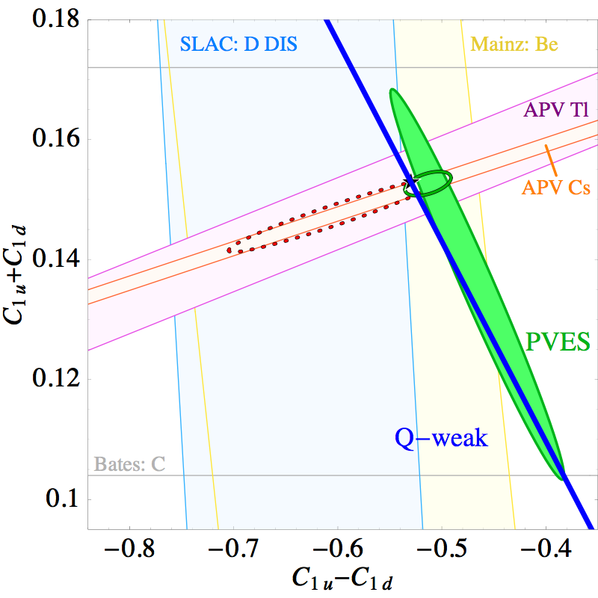
Weak Couplings
All Data & Fits
Plotted at 1 σ
Isoscalar weak charge
Standard Model
Prediction
HAPPEx: H, He
G⁰: H,
PVA4: H
SAMPLE: H, D
Q-weak expected
precision
Isovector weak charge
Notes:
Low Energy Tests of the Standard Model and Fundamental Symmetries

Slide 24
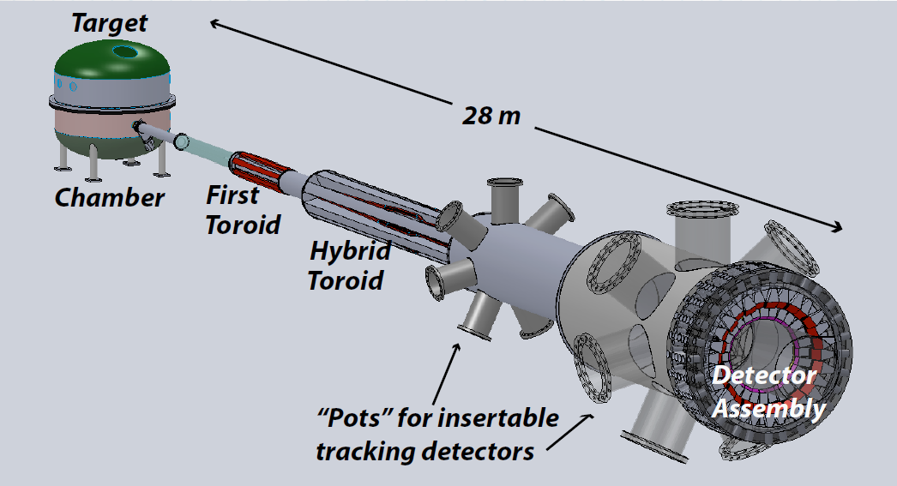
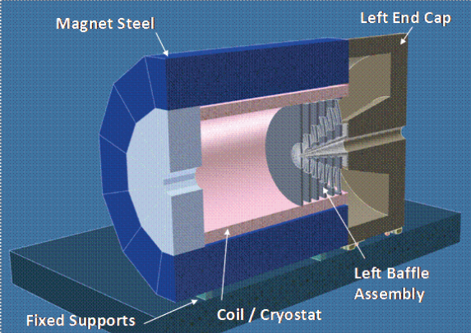
Møller & Deep Inelastic Scattering Parity Violation
Dedicated Møller Experiment
(successor to SLAC E158)
DOE MIE proposal → Physics Review
SoLID: general purpose deep inelastic parity violating experiment with solenoid
Broad scope semi-inclusive deep inelastic physics
Chinese contribution
Notes:
Low Energy Tests of the Standard Model and Fundamental Symmetries

Slide 25
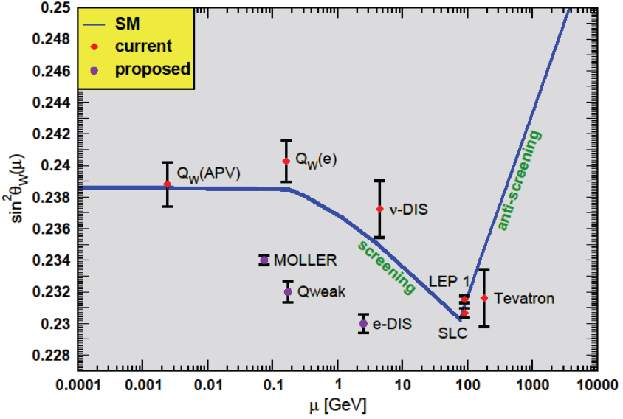
sin²θ_{W}
Notes:
Low Energy Tests of the Standard Model and Fundamental Symmetries

Slide 26
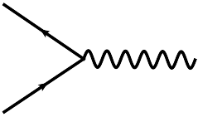

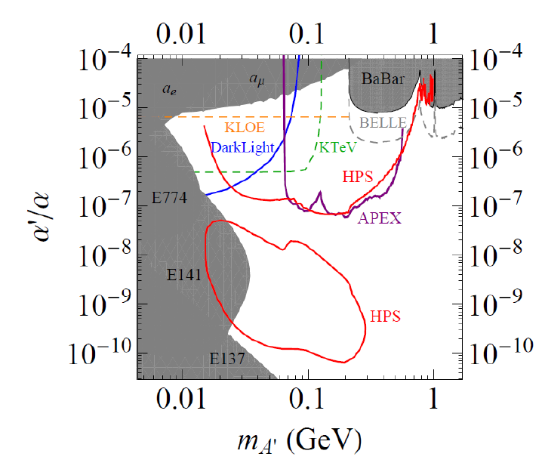
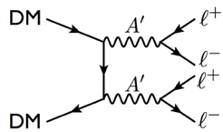
New: Search for a Heavy Photon
Search for new forces mediated by ~100 MeV vector boson A’ with weak coupling to electrons
e⁺
g’
A’
(“dark photon”)
e⁻
small coupling
Motivated by dark matter anomalies:
excess of 10-100 GeV e⁺ flux found by PAMELA satellite (Nature 2009, 1 citation/day)
excess of few-100 GeV e⁺ + e⁻ flux by Fermi satellite/HESS
But - no excess of anti-protons observed!
- observed annihilation rate is large!
Suggests M_{A’} < 1 GeV
→ decay to protons kinematically forbidden
g – 2 preferred!
Irrespective of anomalies:
New ~GeV–scale force carriers are important category of physics beyond the SM
Fixed-target experiments @JLab (FEL + CEBAF) have unique capability to explore this!

Slide 27
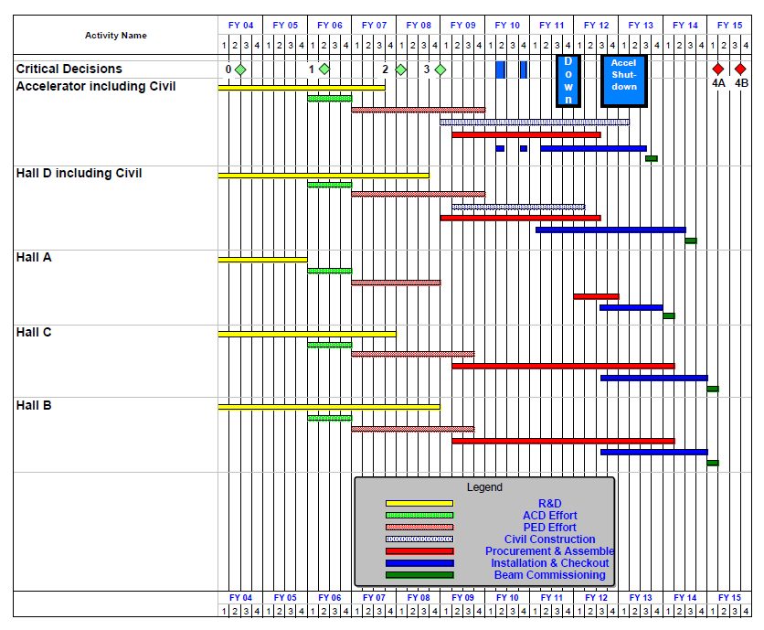
12 GeV Upgrade Schedule
Two short parasitic installation
periods in FY10
6-month installation
May – Oct 2011
12-month installation
May 2012 – May 2013
Hall A commissioning start
October 2013
Hall D commissioning start
April 2014
Halls B/C commissioning start
October 2014
Project Completion
June 2015

Slide 28
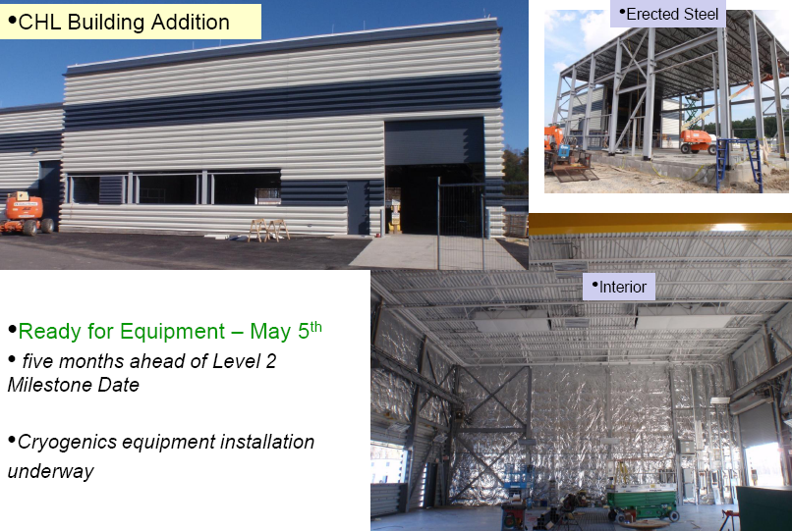
CIVIL CONSTRUCTION – Central Helium Liquefier (CHL) #2
Notes:
Upgrade Project Status

Slide 29
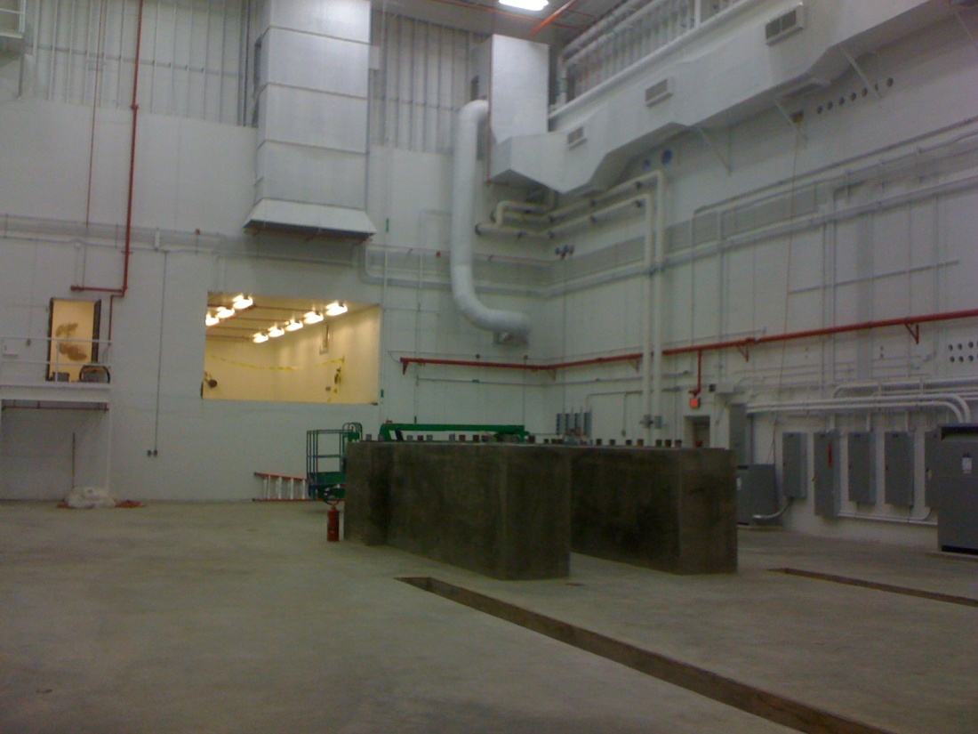
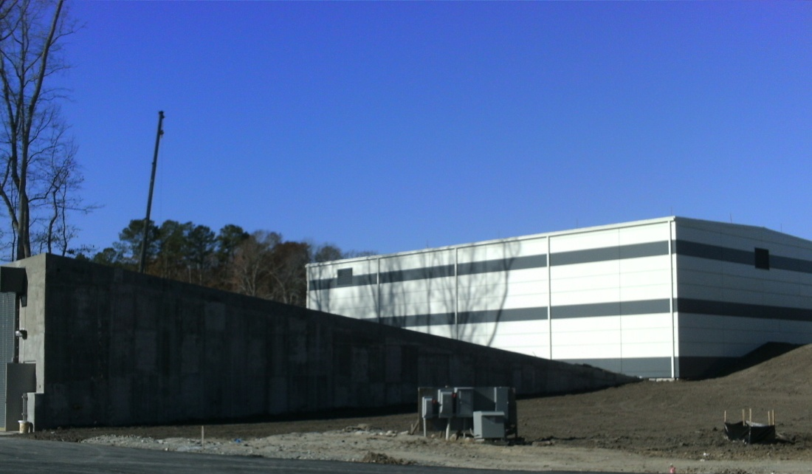
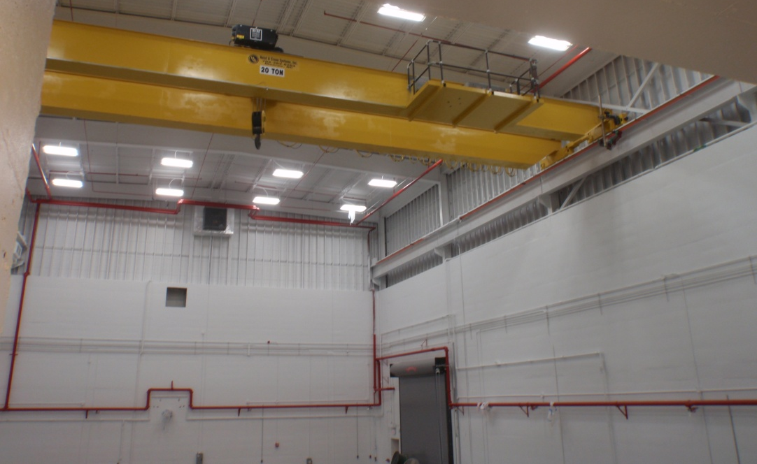
Hall D Status – Dec. 2010
Ready For Equipment (RFE)
Dec. 28, 2010

Slide 30
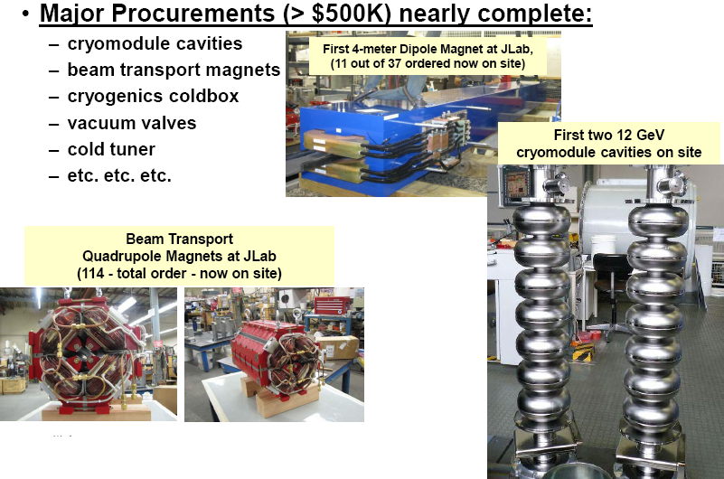
Accelerator Construction Highlights
Notes:
Upgrade Project Status

Slide 31
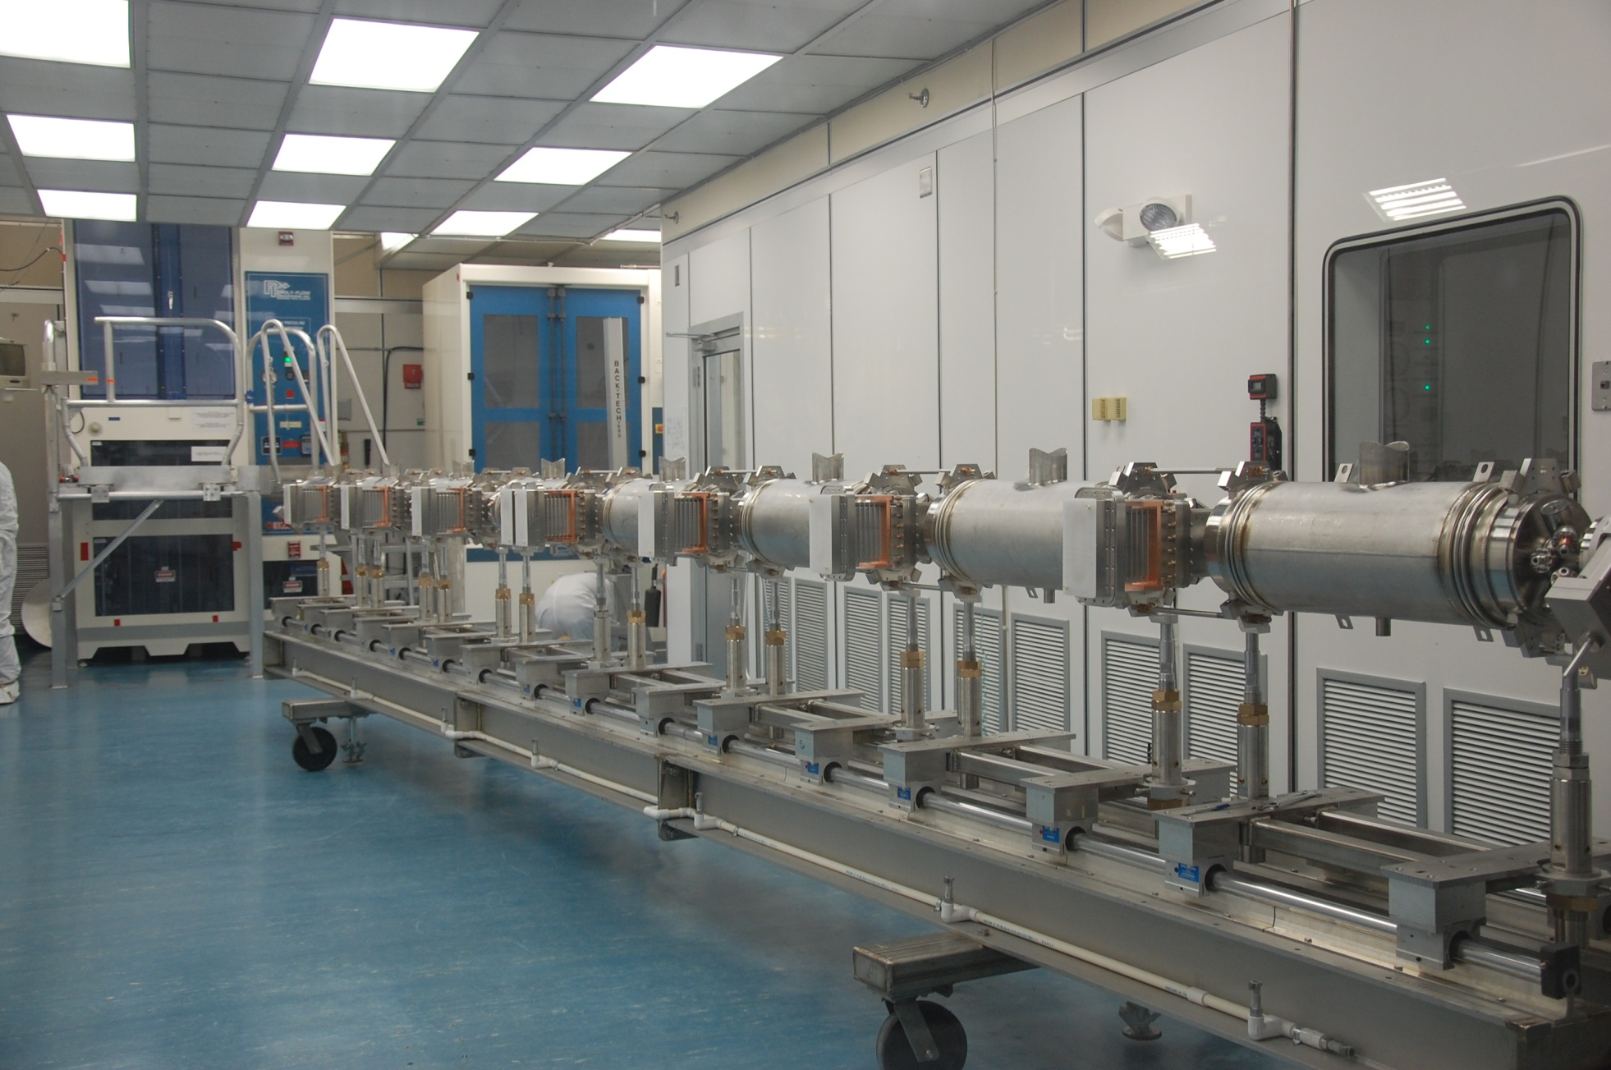
12 GeV Upgrade – Cryomodule Cavity String
January 4, 2011

Slide 32
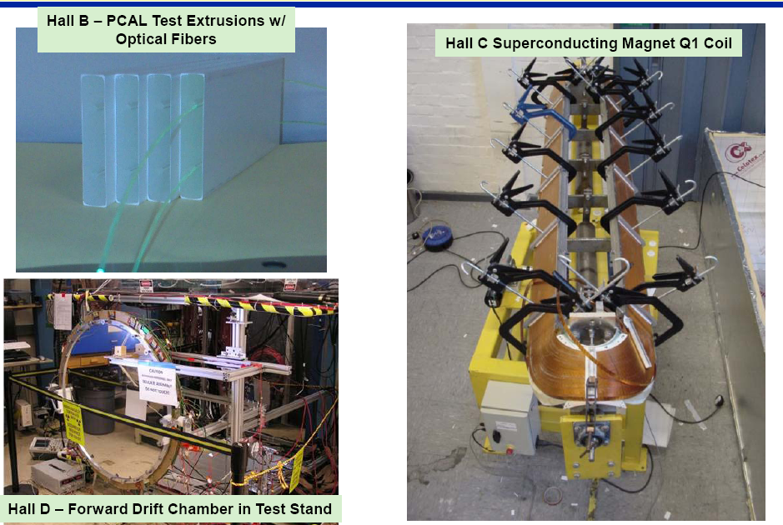
Physics Equipment Construction

Slide 33

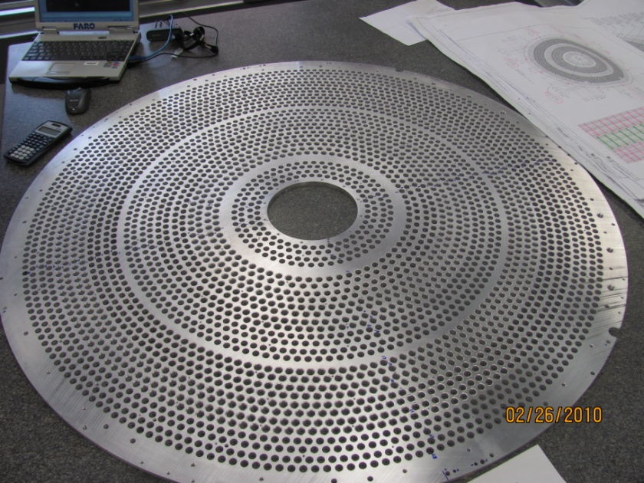
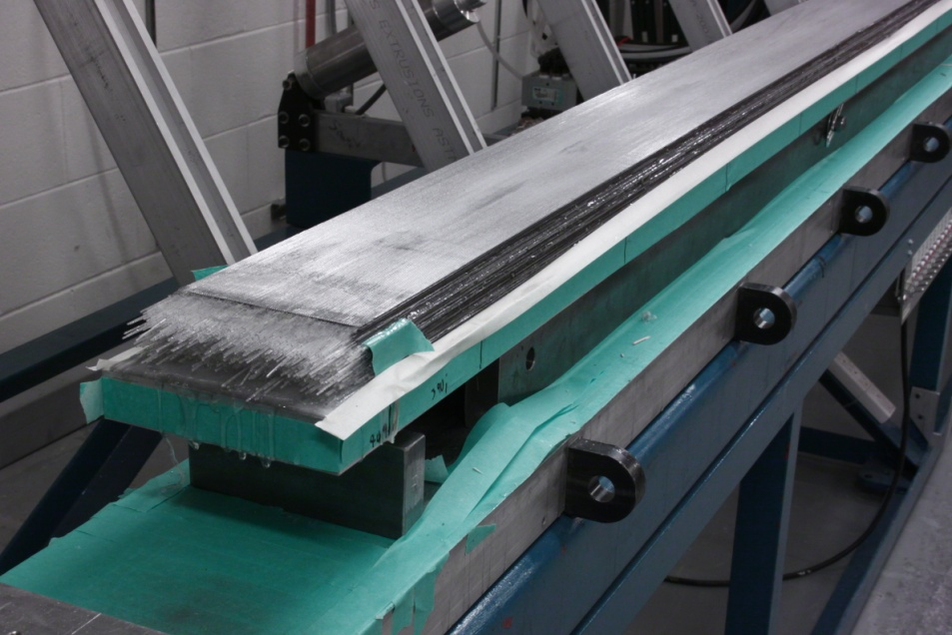
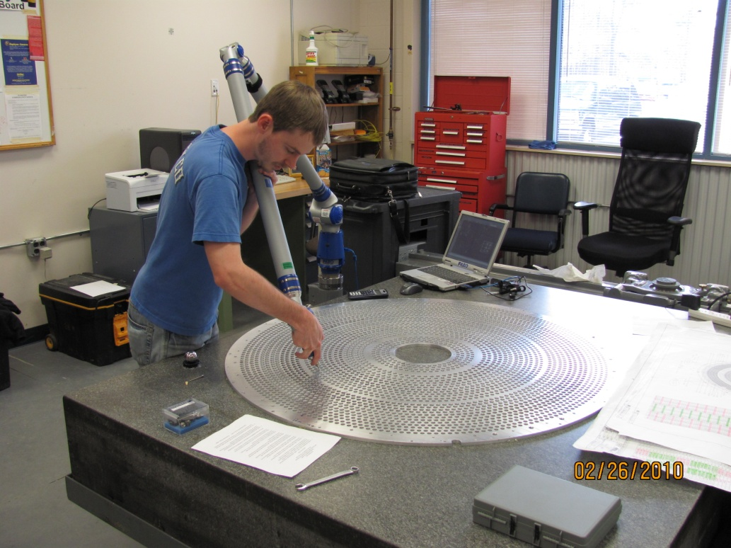






Hall D Detectors
Central Drift Chamber Endplates
Barrel Calorimeter Sixteenth Production Module
The Mighty BCAL Press
Preparing Solenoid Test
First BCAL Modules Arrive!
Notes:
Upgrade Project Status

Slide 34
Jefferson lab 12 GeV Upgrade
An exciting scientific opportunity
Explore the physical origins of quark confinement (GlueX)
New access to the spin and flavor structure of the proton and neutron
Reveal the quark/gluon structure of nuclei
Potential new physics through high precision tests of the Standard Model
Strong User community involvement
NSF MRI and NSERC funding to universities for detector elements
Strong international collaborations and contributions
> 32 PAC-approved experiments – ranking in progress
Accel-Civil-Physics scope leverages the existing facility
Construction is well underway !
Notes:
Upgrade Project Status

Slide 35

Jefferson Lab Light Source
Accelerator R&D and devel.
funded by Navy (ONR) and Air Force
E = 120 MeV emittance 5 microns
135 pC pulses @ 75 MHz 150 fs
ERL
2 FELs
IR (1-10 microns), 14 kW
UV (down to 300nm)
4 eV in fund. 12eV in
3rd harmonic
A VUV/IR/THz 4th Generation Light Source

Slide 36

Brightness as Function of Wavelength
NLS
JLAMP
XFEL
JLAB-UV FEL
JLAMP harm
LCLS
4th Gen
UV harm
FLASH
JLAB-THz
Infrared FELs
3rd Gen
2nd Gen

Slide 37
Potential New Science with JLab VUV FEL
Electronic structure of correlated materials. Johnson (BNL), Shen (Stanford)
Combustion dynamics. Osborn (Sandia)
Atom Trap Trace Analysis (ATTA). Zheng-Tian (ANL)

Slide 38
Atom Trap Trace Analysis (ATTA)
⁸¹Kr half-life 229,000 years – ideal for water/ice in the 10⁵ – 10⁶ year range.
¹⁴C half-life is 5,730 years
Energy level diagram for Kr
Courtesy Lu Zheng-Tian ANL
Notes:
Radioactive Dating, predictability leads to predictable evolution of relative concentrations of isotopes of given element, for example carbon. Choice of element depends on choice of timescale.
Not effective past about 10-20 half-lives
There are subtleties; each usage must be discussed as to the state at Closure Temperature
Krypton dating: half-life is 250k years gives measures in 100,000 --1,000,000 years; cf carbon at 6000 years.
Krypton can also form clathrates with water when atoms of it are trapped in a lattice of the water molecules.
Being radioactive it has a half-life of 230,000 years. Krypton is highly volatile when it is near surface waters but ⁸¹Kr has been used for dating old (50,000 - 800,000 year) groundwater.^{[9]}
Atomic Trapping Trace Analysis (ATTA)
⁸¹Kr is ideal tracer, can get 1:10¹³ sensitivity: ⁸⁵Kr is fission product.
Use 811 nm laser to do the trapping
Greater sensitivity means smaller samples
Need units for L
If reach high efficiency, there are multiple applications.

Slide 39
A Vision for Photon Science at Jefferson Lab
Ultraviolet Laser
(100 mW @ 10 eV)
Today
5 years
Soft X-ray Laser
( 500 eV)
10 years
“Next Generation
Light Source”
(2000 eV X-rays)

Slide 40
Electron Ion Colliders
Design Goals for Colliders Under Consideration World-wide
 | Energies | s | Design Luminosity
(M)EIC@JLab | Up to 11 x 60+ | 240-3000 | Close to 10³⁴
Future ELIC@JLab | Up to 11 x 250 (20? x 250) | 11000 (20000?) | Close to 10³⁵
Staged MeRHIC@BNL | Up to 5 x 250 | 600-5000 | Close to 10³⁴
eRHIC@BNL | Up to 20 x 325 (30 x 325) | 26000 (39000) | Close to 10³⁴
ENC@GSI | Up to 3 x 15 | 180 | Few x 10³²
LHeC@CERN | Up to 150 x 7000 | 4200000 | Close to 10³³
Present focus of interest (in the US) are the (M)EIC and Staged MeRHIC versions, with s up to ~3000 and 5000, resp.

Slide 41

Physics Workshops
R. Gilman, CU, July 2010

Slide 42

EIC Science
Hadrons in QCD are relativistic many-body systems, with a fluctuating number of elementary quark/gluon constituents and a very rich structure of the wave function.
With 12 GeV we study mostly the valence quark component, which can be described with methods of nuclear physics (fixed number of particles).
With an (M)EIC we enter the region where the many-body nature of hadrons, coupling to vacuum excitations, etc., become manifest and the theoretical methods are those of quantum field theory. An EIC aims to study the sea quarks, gluons, and scale (Q²) dependence.
12 GeV

Slide 43
EIC Realization Imagined
Activity Name | 2010 | 2011 | 2012 | 2013 | 2014 | 2015 | 2016 | 2017 | 2018 | 2019 | 2020 | 2021 | 2022 | 2023 | 2024 | 2025
12 Gev Upgrade
FRIB
EIC Physics Case
NSAC LRP
EIC CD0
EIC Machine Design/R&D
EIC CD1/Downsel
EIC CD2/CD3
EIC Construction

Slide 44


Laboratory under Transformation
Superconducting electron accelerator provides 100% duty factor beams of unprecedented quality, with high polarization at energies up to 6 GeV.

Slide 45
Summary
The 6 GeV nuclear physics program is pushing through to 2012 Completion
The 12 GeV Upgrade Project is making excellent progress
Exciting future nuclear physics program (> 10 years)
Future Directions
  Photon Physics Opportunities: Immediate and longer term
  Accelerator Driven Systems - R&D?
  Electron Ion Collider
Jefferson Lab: The Next Decade and Beyond

